Slide 1



Automated micromagnetic numerical simulations incorporating Fourier Neural Operators for demagnetization calculations
Christian Fernandez¹, Cesar Diaz¹, Jorge Munoz¹, Yingheng Tang², Prabhat Kumar², Andy Nonaka², Zhi (Jackie) Yao²
The University of Texas at El Paso¹, Lawrence Berkeley National Laboratory²
APS – March 18th, 2025
1

Slide 2


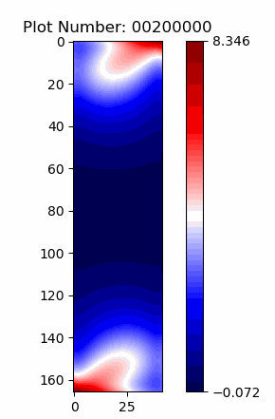
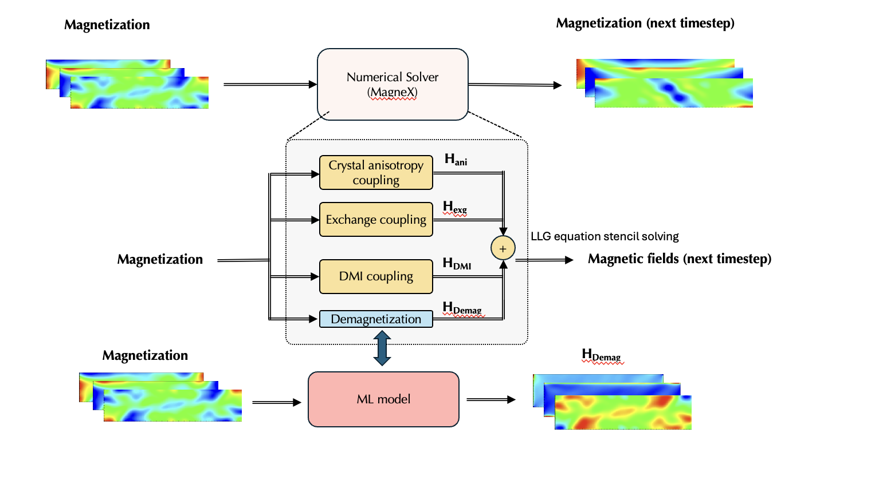
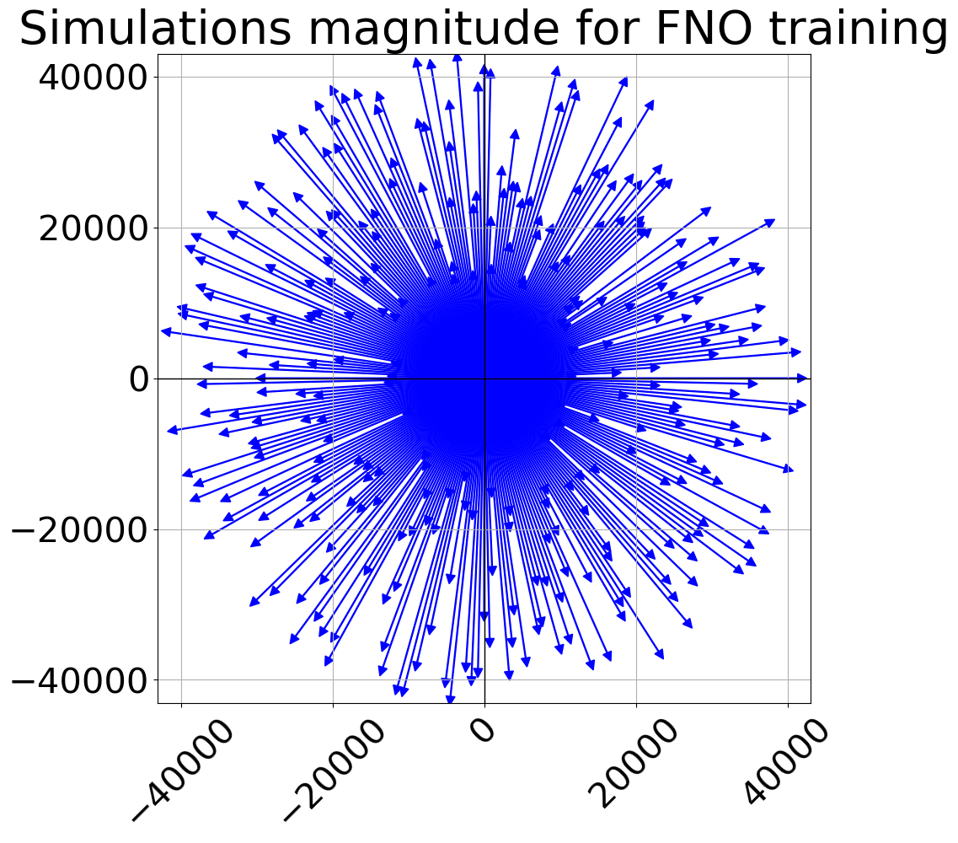
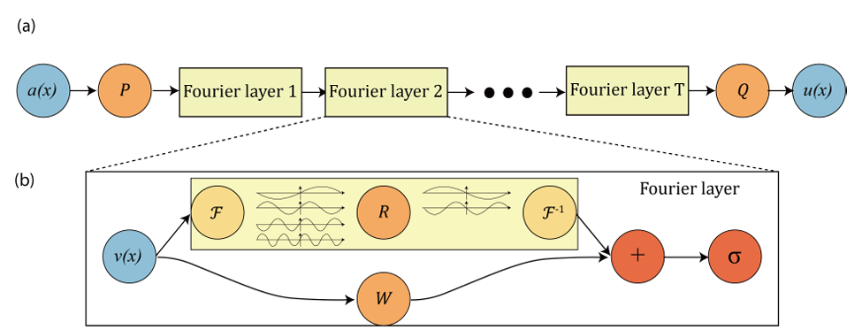
2
Introduction
Microelectronics simulations
Machine learning
UTEP
Generalization
Trained model
Magnex
Machine Learning
Pipeline
Christian A. Fernandez Soria

Slide 3
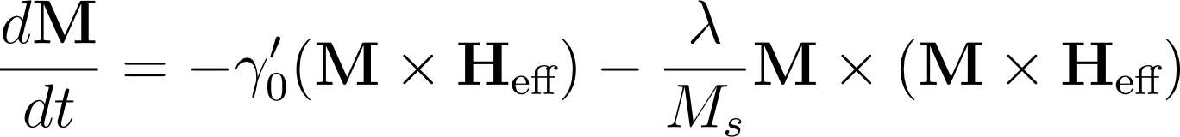
Solver
Microelectronics simulations
Machine learning
UTEP
Generalization
Trained model
MagneX
MagneX solves the Landau-Lifshitz-Gilbert (LLG) equations, including
exchange,
anisotropy,
demagnetization,
and Dzyaloshinskii-Moriya interaction (DMI) coupling.
Build using Amrex
MagneX is a 3D micromagnetics solver for modeling magnetic materials.
MagneX solves the Landau-Lifshitz-Gilbert (LLG) equations, including
exchange,
anisotropy,
demagnetization,
and Dzyaloshinskii-Moriya interaction (DMI) coupling.
Build on Amrex
The algorithm is implemented using Exascale Computing Project software framework, AMReX, fo supercomputing architectures.
3
Christian A. Fernandez Soria

Slide 4
Solver
Microelectronics simulations
Machine learning
UTEP
Generalization
Trained model
MagneX
form the effective field used in the LLG update.
Next presentation from one of the developers of solver: MagneX: A High-Performance, GPU-Enabled, Data-Driven
Micromagnetics Solver for Spintronic Systems. Dr. Andy Nonaka (group lead), LBNL
Christian A. Fernandez Soria
4

Slide 5
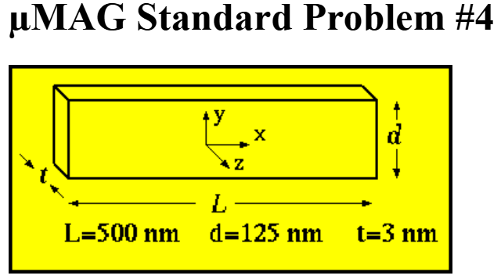
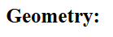
Microelectronics simulations
Machine learning
UTEP
Generalization
Trained model
µMAG Standard Problem #4 - Nist
Standard problem 4 – set up
MagneX – inputs
Damping Factor for λ (damping parameter) : α = 0.5 for t ≤ 1 ns, α = 0.02 for t > 1 ns
Saturation Magnetization: Ms = 8 × 10⁵
Gyromagnetic Ratio: γ = –1.759 × 10¹¹ raad
Exchange Stiffness: A = 1.3 × 10
A film of thickness, t=3 nm, length, L=500 nm and width, d=125 nm will be used.
An equilibrium state is obtained by first applying a saturating field—large enough to reverse the magnetization of the rectangle—and then gradually reducing that field’s magnitude until the system settles
5
Christian A. Fernandez Soria

Slide 6
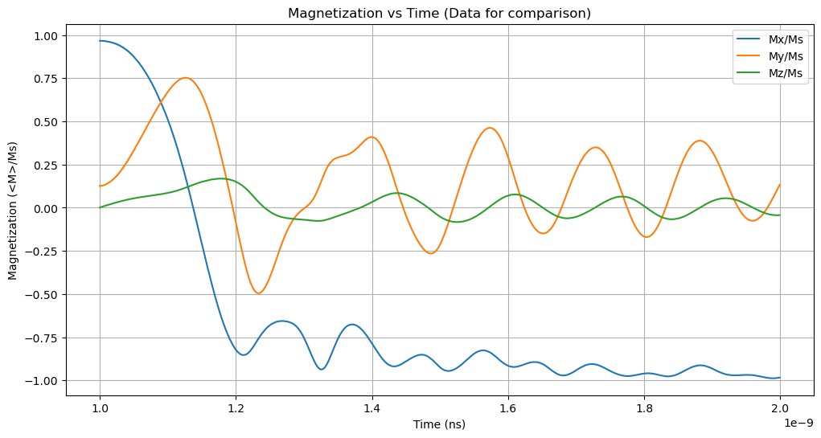
Microelectronics simulations
Machine learning
UTEP
Generalization
Trained model
Numerical performance
MagneX
The (x,y,z) components of the spatially averaged magnetization of the sample as a function of time from t=0 until the sample reaches equilibrium in the new field
The magnetization values in the time series data should be normalized by M_{s}. The time series data is desired so that a detailed comparison can be made between solutions
6
Christian A. Fernandez Soria

Slide 7
Microelectronics simulations
Machine learning
UTEP
Generalization
Trained model
Machine learning
Inside MagneX
Fourier Layers: The model applies spectral and regular convolutions in four layers:
Spectral Conv: SpectralConv2d applies an FFT to convert data to frequency space, then uses an inverse FFT to return to spatial data.
Regular Conv: A 1x1 convolution (self.w0) captures local patterns to enhance the Fourier-based transformations.
Li, Z., Liu, B., Kovachki, N., Bhattacharya, K., Stuart, A., Azizzadenesheli, K., & Anandkumar, A. (2021). Fourier Neural Operator for Parametric Partial Differential Equations. International Conference on Learning Representations (ICLR).
7
Christian A. Fernandez Soria

Slide 8
Microelectronics simulations
Machine learning
UTEP
Generalization
Trained model
ML in Magnex
Each coupling component (Crystal anisotropy, Exchange, DMI, and Demagnetization) contributing magnetic fields for the Landau-Lifshitz-Gilbert (LLG) equation. We specifically implement the Fourier Neural Operator (FNO) within the Demagnetization stage, replacing the traditional numerical solution in MagneX, with the FNO technique.
8
Christian A. Fernandez Soria

Slide 9

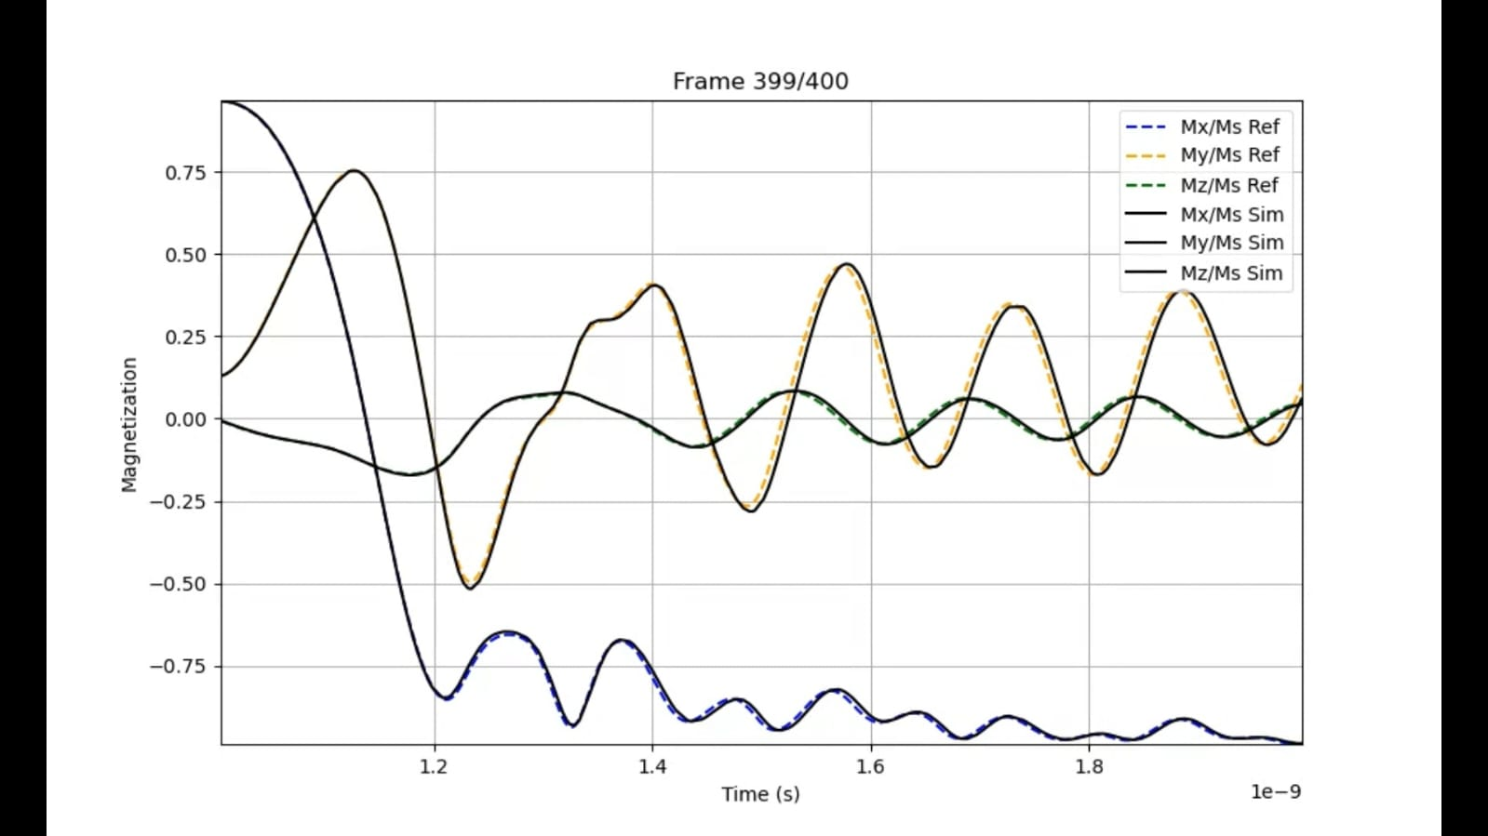
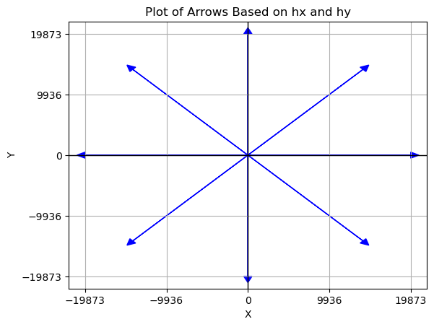
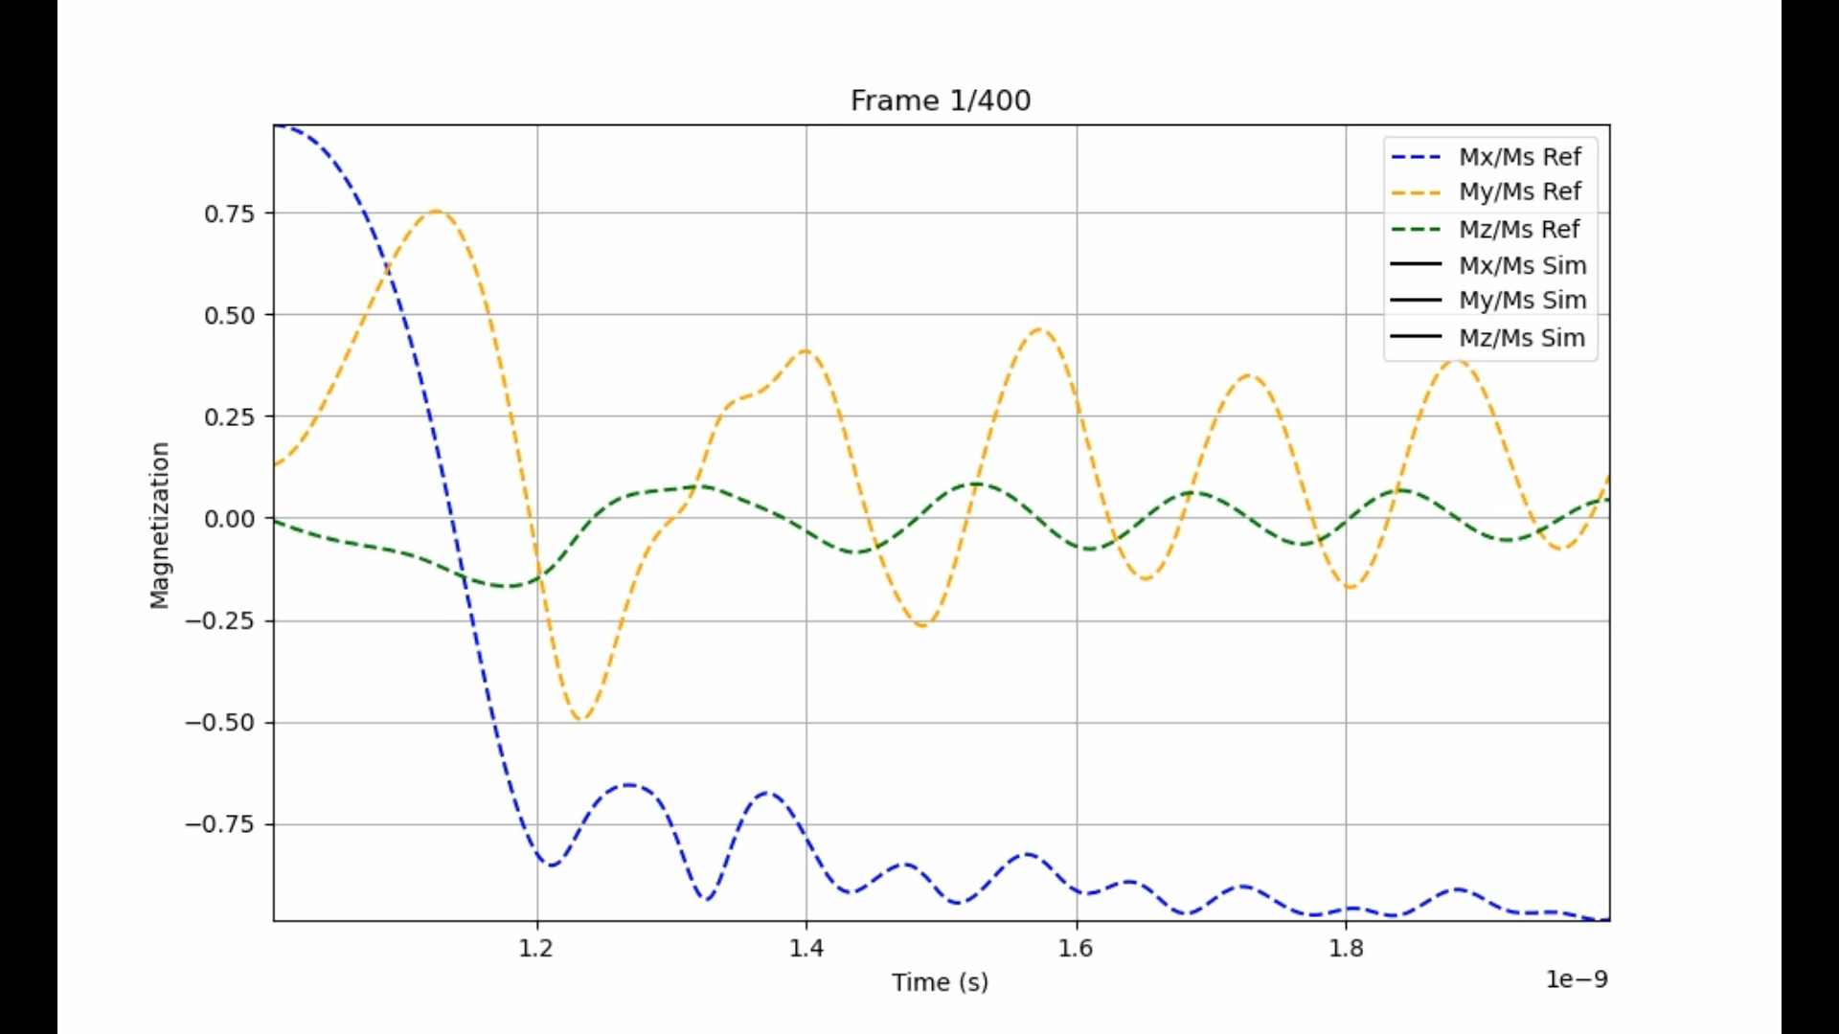
Microelectronics simulations
Machine learning
UTEP
Generalization
Trained model
ML Original data base
Field 1 – performance
Recalling from standard problem 4: a field approximately 25 mT, directed 170 degrees counterclockwise from the positive x axis
8 simulations were created for model 01
9
Christian A. Fernandez Soria

Slide 10

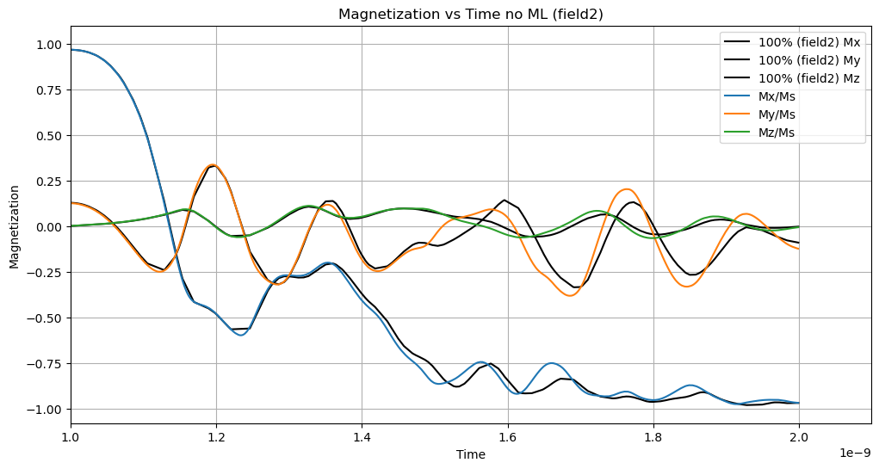
Microelectronics simulations
Machine learning
UTEP
Generalization
Trained model
Field 1 – performance
ML Original data base
Field 2 (different case) performance
Recalling from standard problem 4: a field approximately 25 mT, directed 170 degrees counterclockwise from the positive x axis
8 simulations were created for model 01
10
Christian A. Fernandez Soria

Slide 11
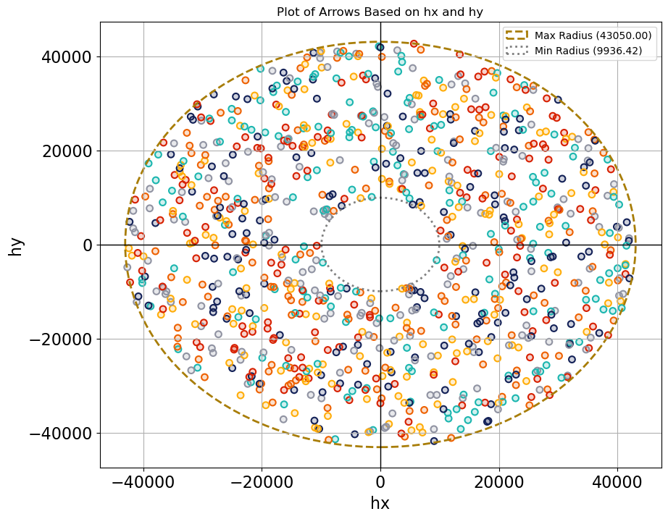
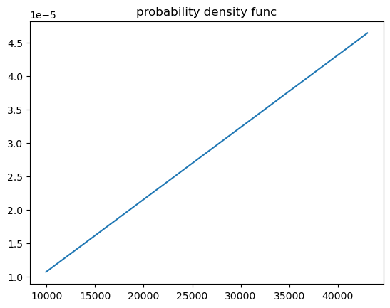
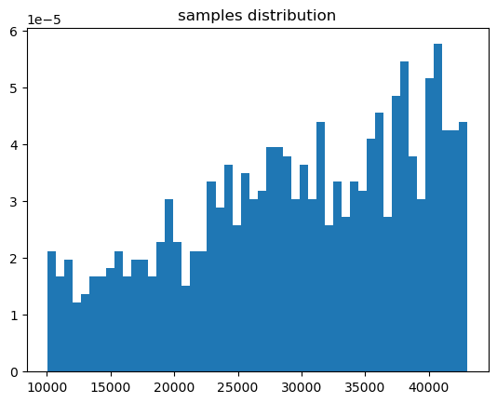
Microelectronics simulations
Machine learning
UTEP
Generalization
Trained model
UTEP – Utility To Execute Pipelines
Triangular distribution
11
Christian A. Fernandez Soria

Slide 12
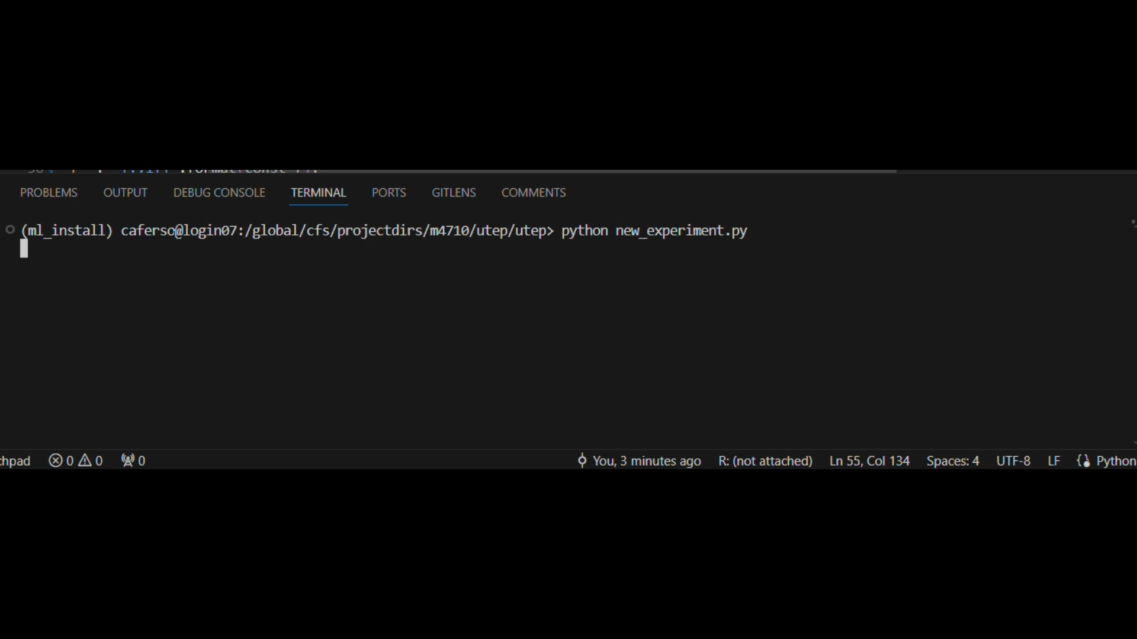
Microelectronics simulations
Machine learning
UTEP
Generalization
Trained model
UTEP – Utility To Execute Pipelines
12
Christian A. Fernandez Soria

Slide 13
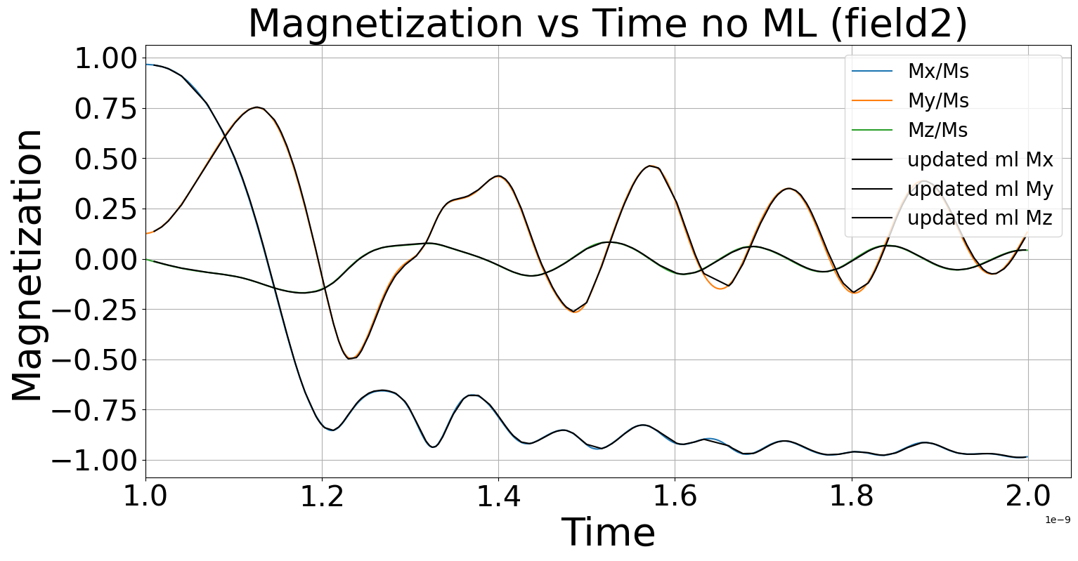
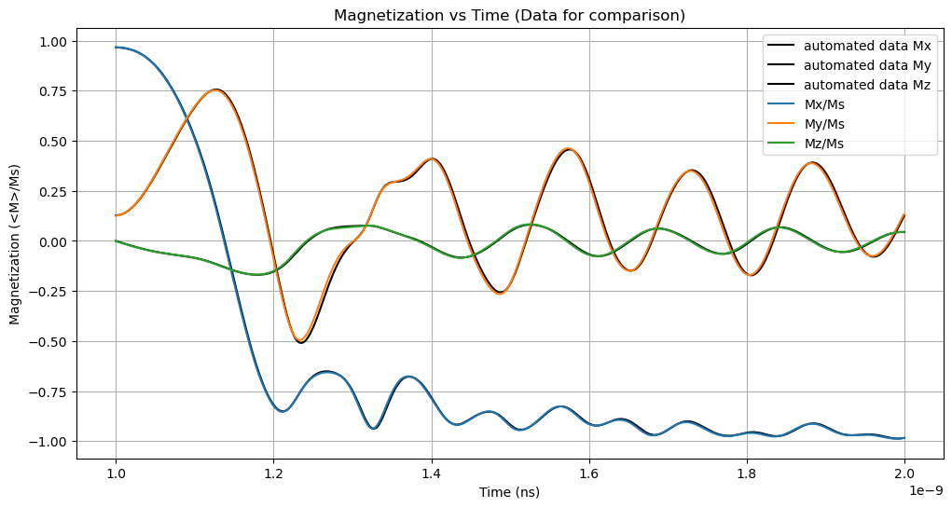
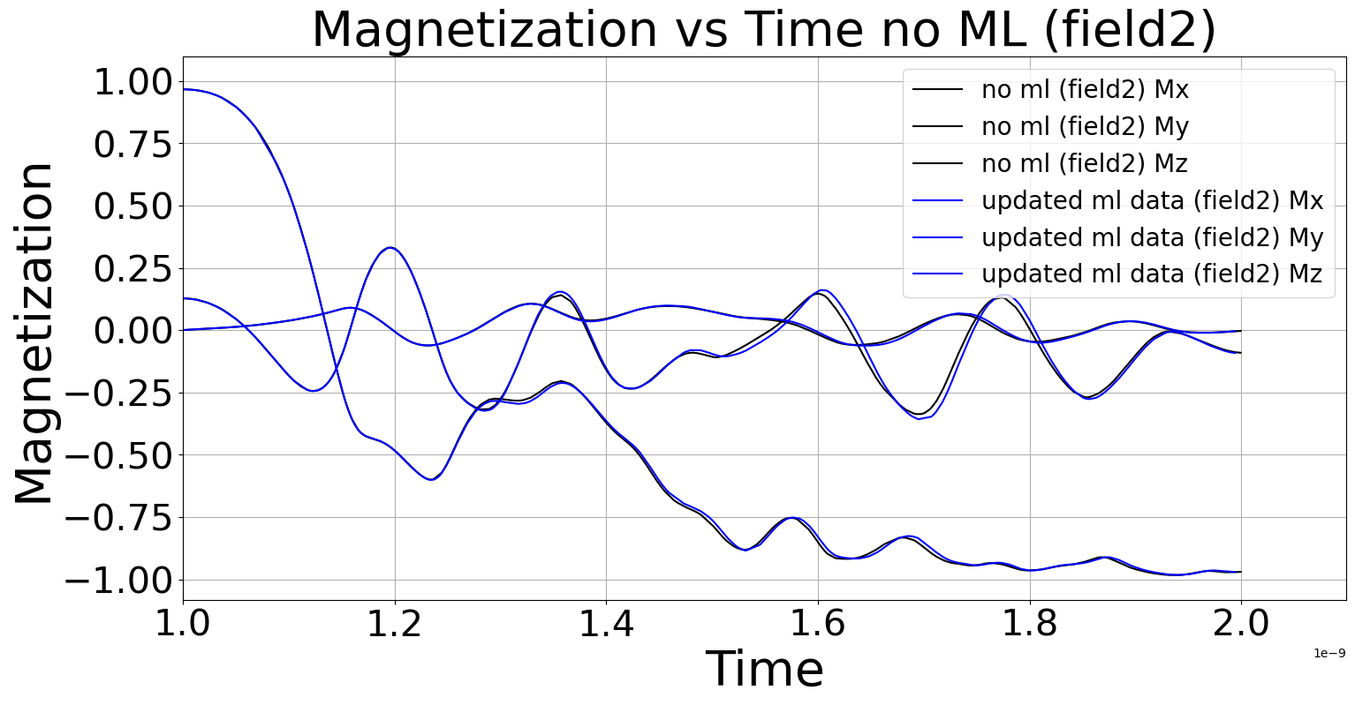
Microelectronics simulations
Machine learning
UTEP
Generalization
Trained model
Previous data base
New data base
Field 1
Field 1
Field 1
Field 2
Field 2
13
Christian A. Fernandez Soria

Slide 14
Conclusion
Microelectronics simulations
UTEP
Generalization
Trained model
Accuracy: Both ML (FNO-based) and numerical approaches achieve similar accuracy in magnetization dynamics.
Performance Comparison:
ML (FNO-based): Total runtime ~3686 seconds.
Numerical: Total runtime ~1382 seconds.
Efficiency: Numerical approach is approximately 3x faster than ML while maintaining accuracy.
FNO for PDE solvers
The numerical approach is currently more efficient for real-time applications due to faster execution. ML (FNO) could be viable with further optimization.
14
Christian A. Fernandez Soria

Slide 15
Thank you!
Thank you!
15
Christian A. Fernandez Soria

